Slide 1

Project Presentation
IPL DATASET 2023

Slide 2
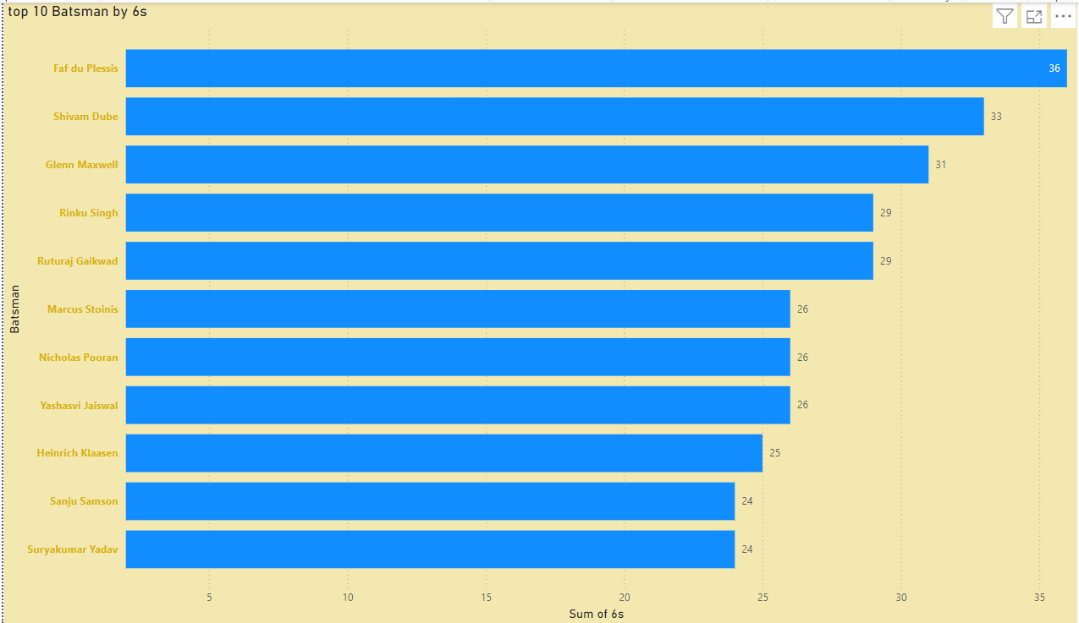
This is a clustered bar chart in which I have provided top 10 batsman in which batsman has hit 6 sixes.
Insights
The fact that these batsman have achieved the milestone of hitting 6 sixes in a single innings indicates exceptional power hitting ability.
This performance can be used as a benchmark for assessing the striking capabilities of others players.

Slide 3
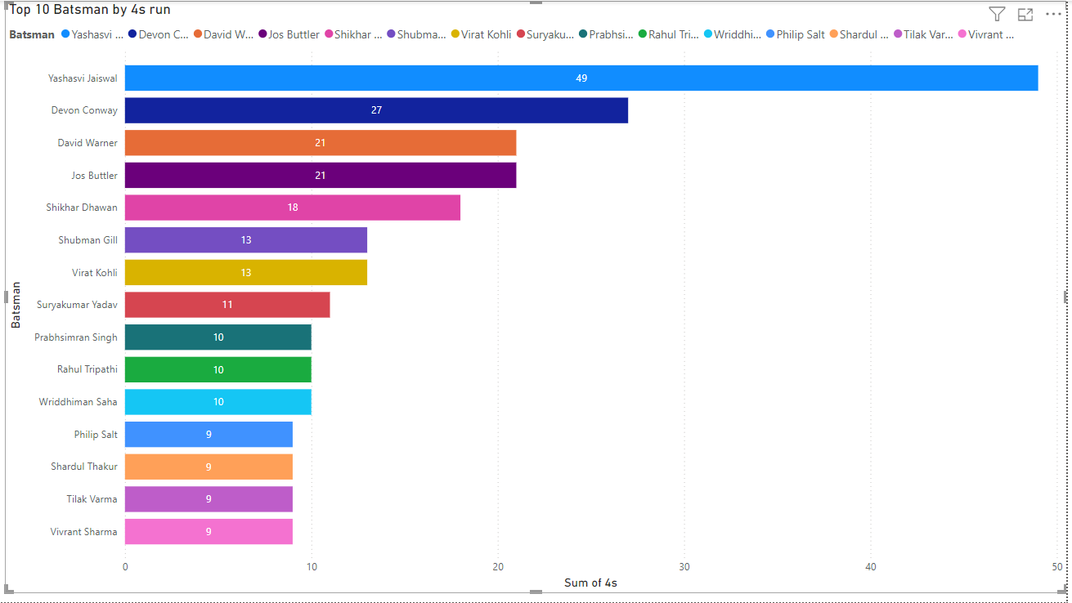
Analyzing a stacked bar chart that display top 10 batsman with the most fours can yield several insights into their batting styles, performance and contributions to their teams.
Insights
The number of fours hit by each batsman indicates their ability to score runs quickly and efficiently.

Slide 4
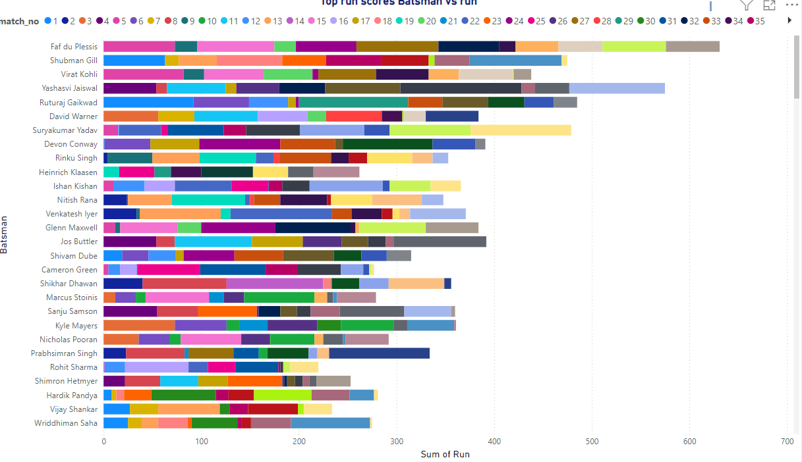
Top Run score batsman vs Run
Here identify top Performers batsman using stacked bar chart .
Insight :
The stacked bar chart reveals that certain batsman consistently dominate run scoring,
Showcasing their ability to accumulate high totals across different formats.

Slide 5
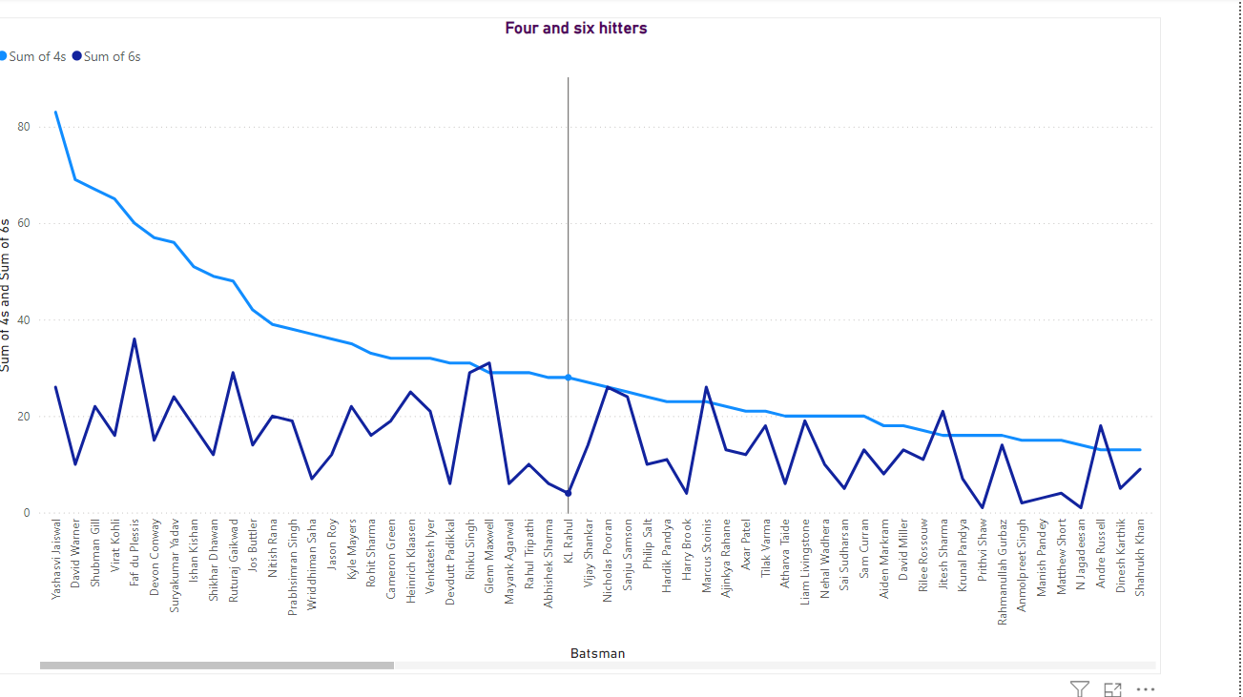
Creating insights for the four and six hitters in a match using a line chart in Power BI can help you analyze player performance and the overall dynamics of the game
Insights Analyze the strike rates of six hitters in relation to their total runs scored.
Using the line chart, visualize player performances over time to identify trends and irregularities. This could inform player selection and training focus.

Slide 6
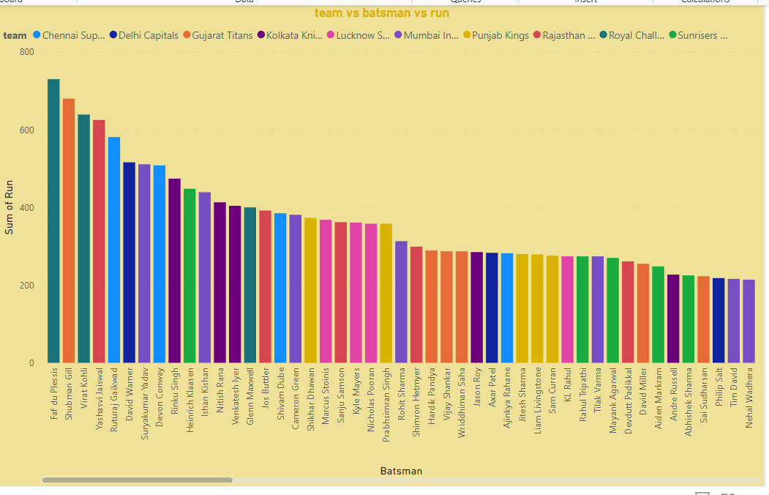
Using a stacked column chart to visualize the performance of teams against runs scored by individual batsmen provides a clear and insightful way to examine contributions from both teams and players.
Understanding individual contributions in relation to total team runs can help coaching staff and analysts devise future strategies for selection, training focus, and match preparation.
Identification of batsmen consistently contributing less can lead to targeted development and performance enhancement strategies.

Slide 7
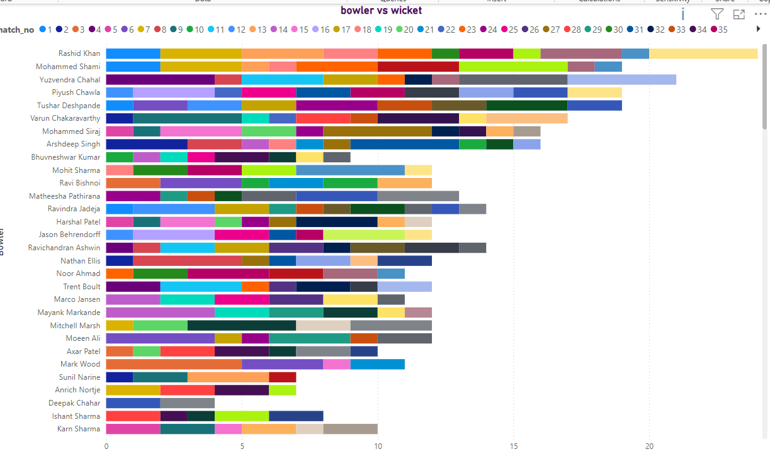
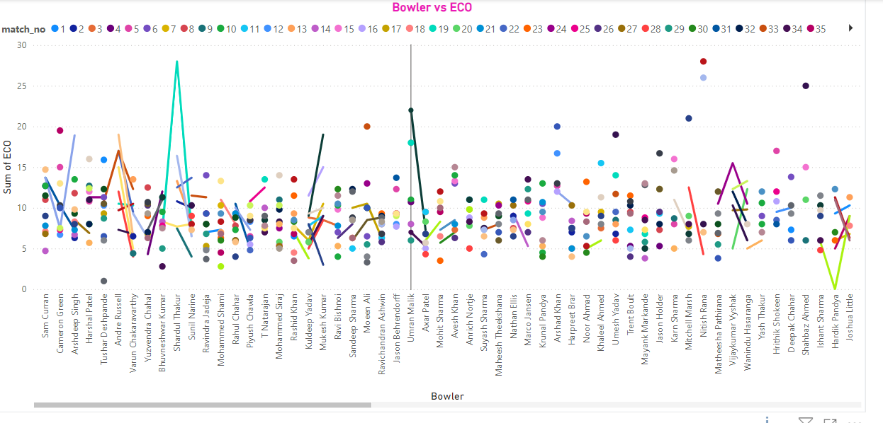
Here used stacked bar chart that analyzes top wicket takers, showcasing bowlers against the number of wickets taken.
By examining past performance and wicket trends, analysts can make educated projections about future matches, including which bowlers may be key players and their likely performance in varying conditions.
The line chart allows for easy observation of how each bowler’s economy rate has changed over matches or seasons.
he line chart effectively captures the nuances of bowler performances related to their economy rates. These insights are valuable for coaches, analysts, and team management in strategizing player selections, match strategies, and identifying areas for improvement based on historical data patterns.

Slide 8
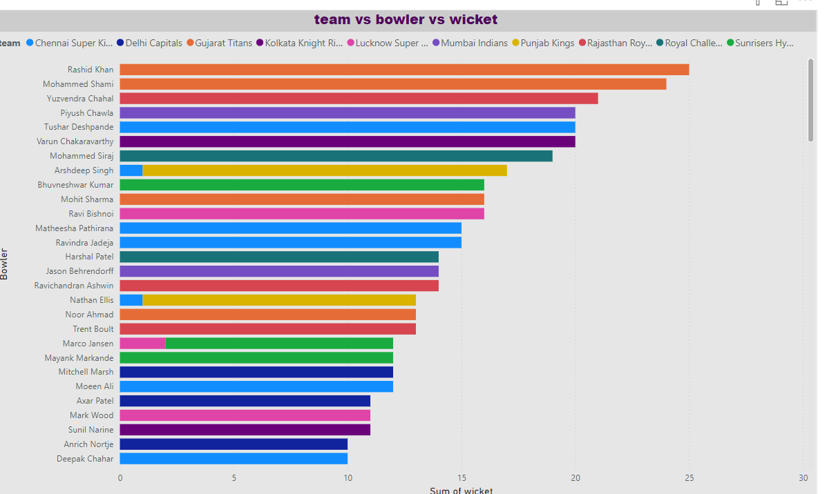
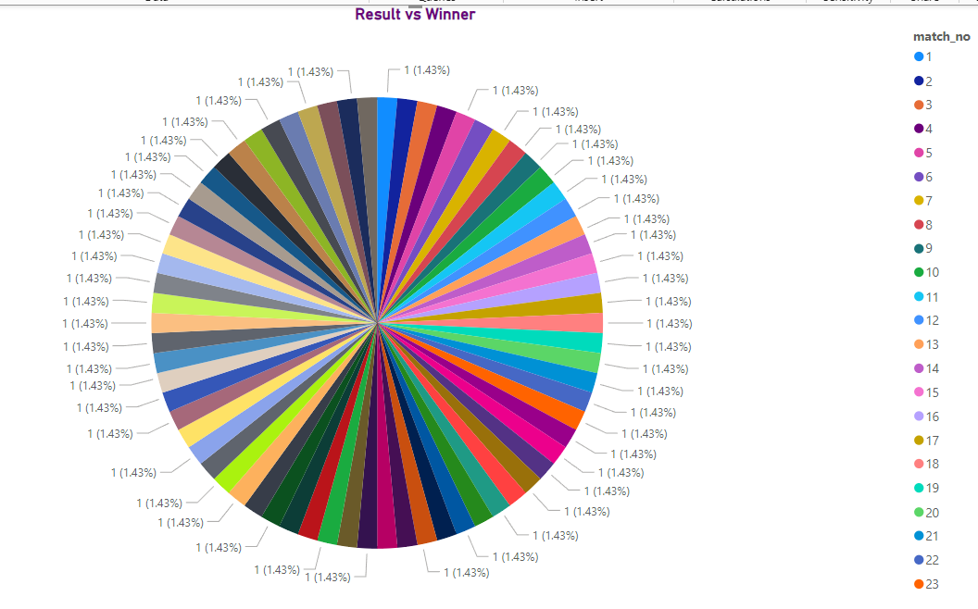
Here are created stacked bar chart for bowler performance.
Analysis of the components of the stacked bars can help identify strengths (high wicket count, low runs) and weaknesses (high runs conceded) that bowlers may need to work on. Targeted training can then be implemented to improve weaker aspects. Ultimately, the visual representation provided by the stacked bar chart enhances the understanding of bowlers’ contributions to the team's overall success.
This pie chart for match result
The pie chart provides a clear visual representation of the proportion of matches won versus lost. A large segment of the chart representing wins indicates a strong performance throughout a series or season, while a larger segment for losses may indicate areas for improvement.
Understanding the win/loss mix can help coaches and selectors make data-driven decisions regarding which players to prioritize for upcoming matches based on previous outcomes against particular opponents.

Slide 9
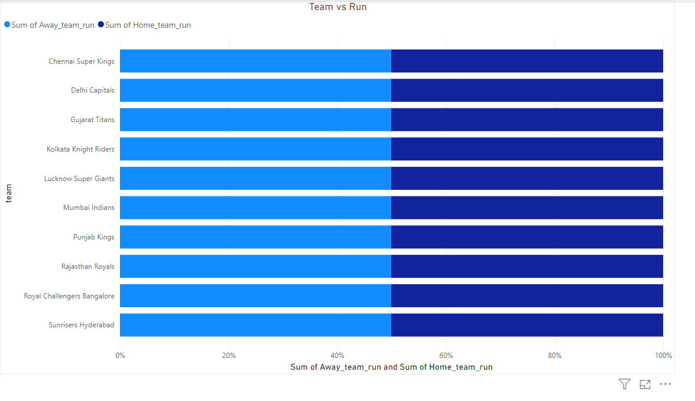
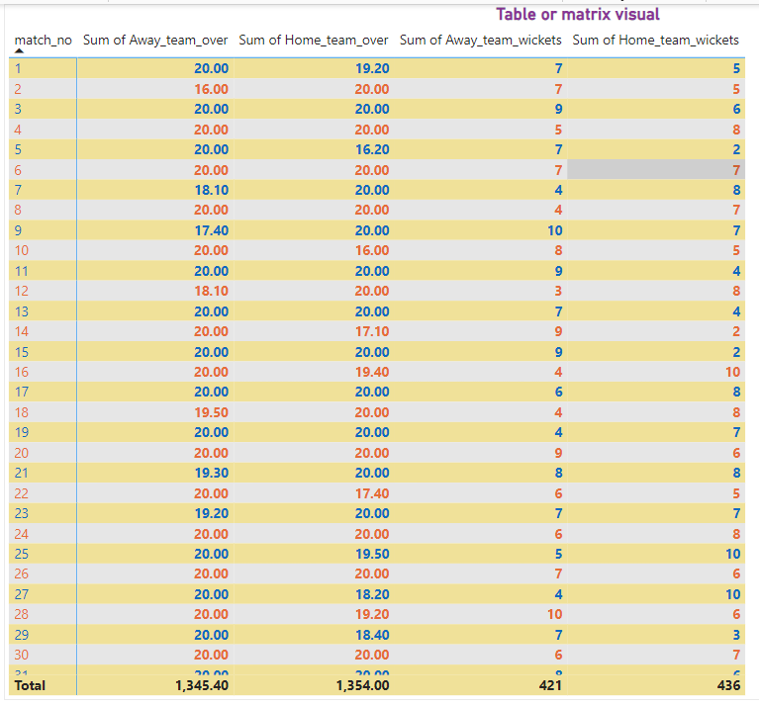
stacked bar chart that illustrates team performance, comparing runs made by different teams across various matches or seasons
Analyzing the individual contributions in the stacked segments can help assess how well-reserved players perform when given opportunities, indicating depth in squad strength and potential options for rotation.
Table matrix is used for match summary
A table matrix for match summaries is a powerful tool for collating, analyzing, and interpreting match data across statistics and outcomes. It provides a clear, organized approach to understanding team and player performances, trends, and key insights that can inform future strategies and decision-making.

Slide 10
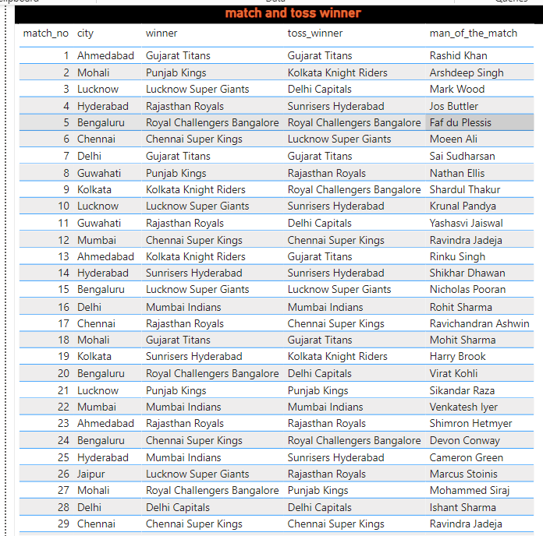
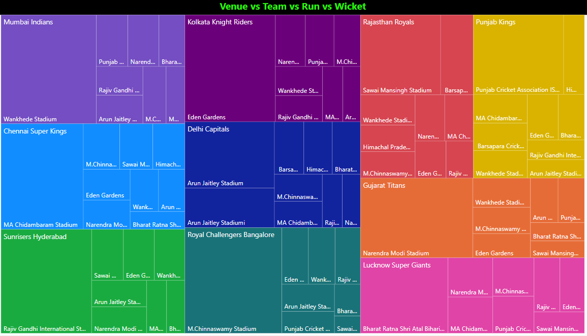
When analyzing match winners and toss winners using a table chart, you can derive a multitude of insights regarding the relationships between toss outcomes and match results, as well as trends and strategies employed by the teams
The insights drawn from a table chart illustrating match winners and toss winners provide a comprehensive view of the importance of toss outcomes relative to match results. Analyzing these relationships helps identify strategic patterns, historical performance benchmarks, and potential areas for improvement for teams and players involved.
Tree map :A tree map is an excellent way to visualize venue-wise performance.
Performance data visualized could prompt deeper analysis into whether certain venues correlate with player injuries or fitness levels, which can be crucial for future squad selections and preparation.
Insights can be derived regarding how coaches adapt their gameplay and strategies based on previous performances at specific venues, highlighting successful coaching tactics unique to certain grounds.

